Slide 1


Hangman Game Project
Discover the secrets of building an addictive Hangman Game in Python. Dive into the challenge, unravel the objective, explore its functionality, and witness the thrilling output of this captivating project.
Surya KP (RA2211026010378)
Koushik Vishal (RA2211026010384)
Akash RV (RA2211026010376)

Slide 2

Objective
The primary objective of the Python Hangman game is to provide players with an entertaining and educational platform for honing their word-related skills. Players are invited to solve concealed words by guessing letters, employing their vocabulary, spelling, and deduction abilities. The game also seeks to create a sense of achievement and satisfaction when players successfully decipher words, adding a competitive edge to the gaming experience. Through this objective, the game bridges the gap between entertainment and mental exercise.

Slide 3

Problem Statement
The challenge that the Hangman game addresses is two-fold. Firstly, it seeks to offer an engaging and user-friendly digital version of a traditional game while retaining the core elements that make Hangman so beloved. Secondly, the game endeavors to provide an effective and enjoyable tool for enhancing language skills, vocabulary, and cognitive abilities. The problem statement revolves around striking the right balance between entertainment and education, creating an intuitive interface, and offering an enjoyable gaming experience.

Slide 4
Functionality
Word Selection
User Interaction
Guess Limits
Win/Loss Conditions
The player has a set number of attempts to guess the mystery word fully. The game ends after reaching the guess limit.
The program randomly selects a word from a predefined list and assigns it as the mystery word.
The player guesses letters one by one. The program checks if the letter is in the mystery word and updates the display accordingly.
If the player correctly guesses the word within the guess limit, they win. Otherwise, the game ends in a loss.

Slide 5

What Makes Our Project Unique
Traditional Charm, Modern Appeal: A fusion of classic Hangman charm with modern digital features, delivering an engaging yet familiar gaming experience.
Educational Fun: Seamlessly integrating learning with entertainment, providing a relaxing yet educational platform for language skill enhancement.
Inclusive Design Philosophy: User-friendly interface accommodating diverse players, offering relaxation for casual gamers and mental stimulation for language enthusiasts.
Perfect Balance: Harmonizing relaxation and intellectual engagement, ensuring a stress-relieving yet mentally stimulating gaming atmosphere.
Tangible Educational Gains: Demonstrating measurable improvements in language skills and cognitive abilities, fostering relaxation alongside learning outcomes.

Slide 6
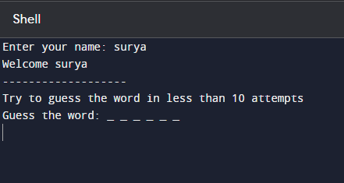
Output Snippets:

Slide 7
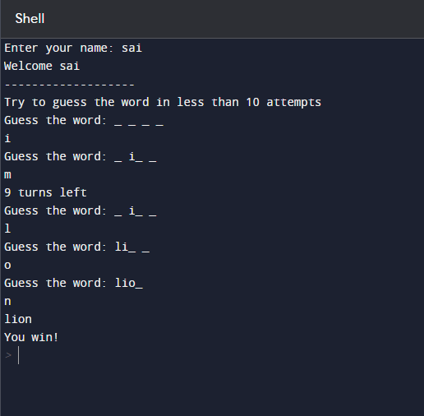

Slide 8
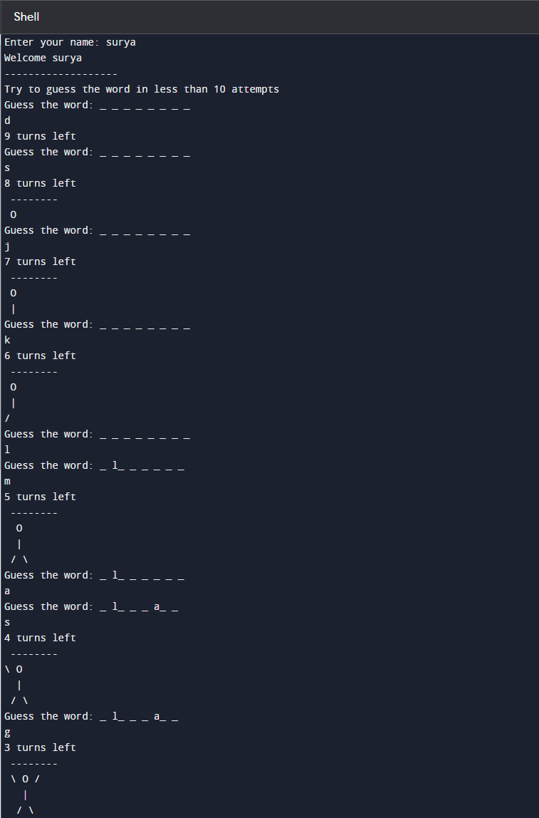

Slide 9
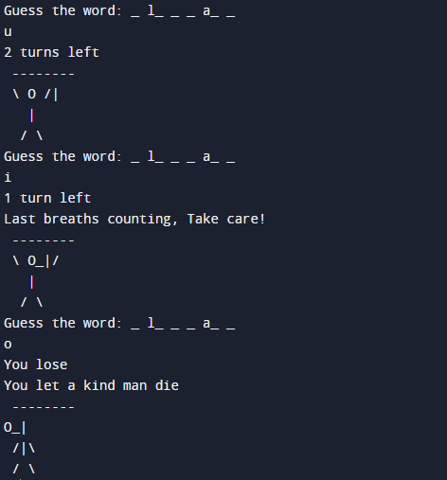

Slide 10

Conclusion
The Python-based Hangman game project harmonizes tradition with innovation, offering an engaging gaming experience that seamlessly integrates relaxation and educational enrichment. Its user-friendly design appeals to diverse players, providing both leisure and mental stimulation. Moreover, the game's tangible educational impact, observed through improved language skills, underscores its significance as an entertaining and effective learning tool. In essence, this project stands out as a unique fusion of entertainment, education, and relaxation, marking its distinction in the realm of gaming.

